Slide 1
The Search for Exoplanets and other earths
Analysis in the search for extraterrestal life and future colonization

Slide 2
Hypotheses
Hypo 1: We have bias in the stars we analyze for exoplanets
G2 stars like are sun have a temperature between 5300K and 6000K as well as a radius of .84 solar masses to 1.15 solar masses
Hypo 2: Most earth type planets have G2 stars. “Earth-like” planets for the sake of this study are planets that have a temperature equilibrium of 228K to 339K (-50F to 150F)

Slide 3
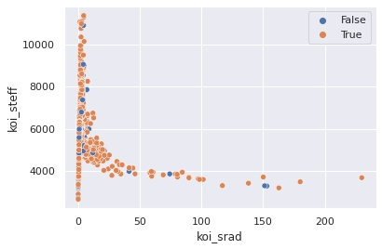
Star temperature vs. radius. Hue is false positives for exoplanets

Slide 4
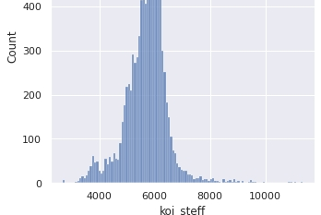
Number of stars studied for exoplanets and their temperature

Slide 5
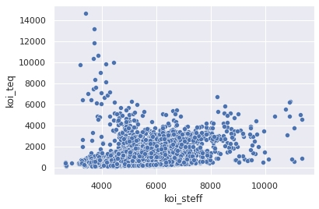
Planet Eq temperature vs. Star temperature

Slide 6
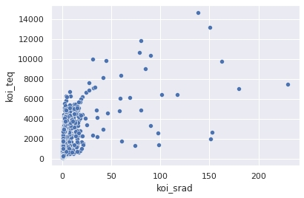
Planet Eq Temperature vs. Size of the star

Slide 7
CONCLUSIONS
Hypo 1 Rejects the Null- within 95 percent we have shown bias toward G2 stars in our research
Hypo 2 Rejects the Null- within 95% we have shown the the majority of earth-like planets have a G2 star
As the findings of this report indicate, we should continue looking for earth-like planets looking at G2 planets

